Slide 1


Modeling and Experimenting with Transactive Energy Use Cases
(with GridLAB-D Design Studio)
Email: yuxin.wu@vanderbilt.edu
Date: 08/06/2020
Advised by Himanshu Neema

Slide 2
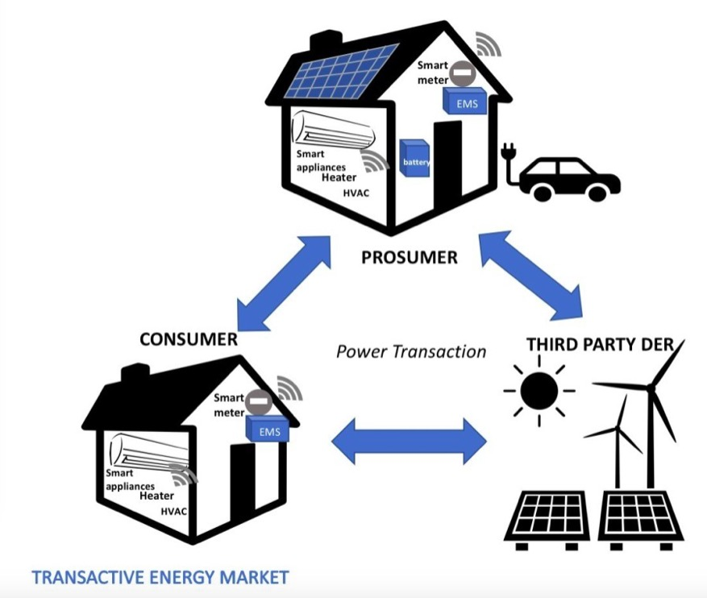
Transactive Energy
What is Transactive Energy?
The smart grid
DERs (solar panels, wind turbines, etc)
Houses(appliances, controllers, etc)
Balance the supply and the demand for energy based on the price of energy
Image source: https://theenergybit.com/2020/03/10/smart-disruption-the-internet-of-energy-and-transactive-energy-system/

Slide 3
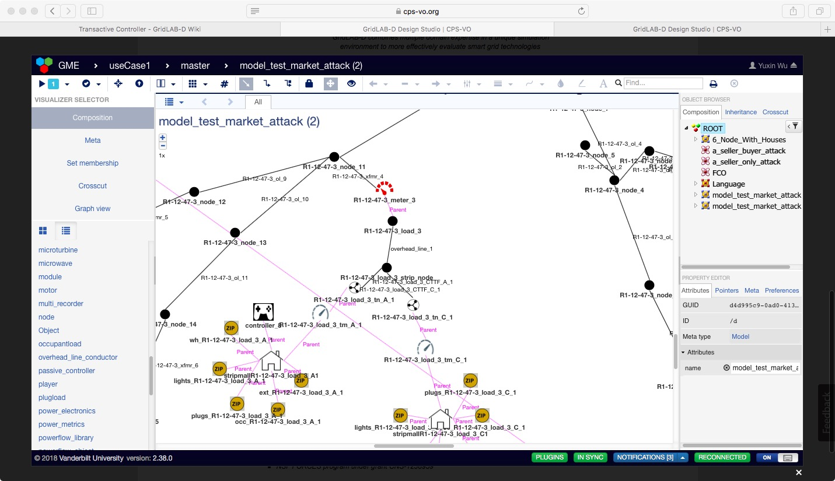
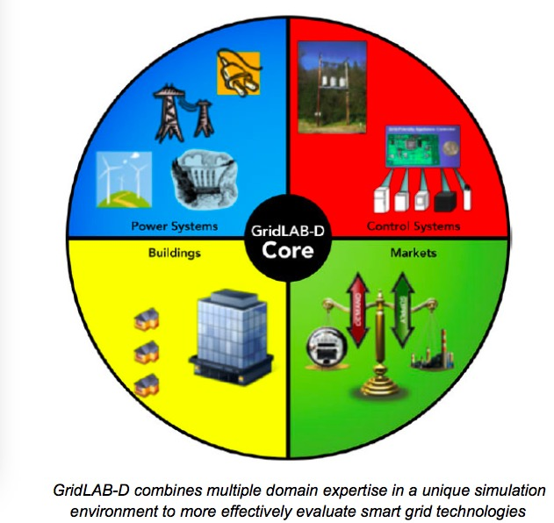
GridLAB-D Design Studio
Web-based platform hosted on CPS-VO.org for modeling and simulating different power-grids
Convert textual code into easily manipulatable GUI
Plugin(s): SimulationWithGLD by server in cloud, GenerateGLDModel, etc
Image source: https://cps-vo.org/group/gridlabd

Slide 4
TE Experiments Conducted
Use Cases Strategies
Use Case 1: Peak Load Management controllers, market
Re-balance the system using price
Use Case 2: Wind Energy Balancing Reserves windturb_dg
Balance demand and supply
Use Case 3: High-Penetration PV and Voltage Control battery
Use Case 4: Electric Vehicle Charging Time Coordination evcharger_dt
Use Case 5: Island Mode Microgrid Balancing switch
Balance demand and supply
Use Case 6: Sudden Loss of Supply Management transformer_configuration
Description: Thick clouds cover the sunlight. Solar panels cannot generate sufficient energy. Peak demand load occurs. (demand > supply)
Description: As wind energy becomes the main source of energy generation in the grid, we need to deal with the issue of instability of wind power. (demand > supply)
Description: Large amount of excessive energy produced by solar panels will cause the reverse power flow that destabilizes the grid. So we have to manage the excessive energy using storage devices.
Description: When all of EVs get charged at the same time at night, the peak demand situation occurs. We have to coordinate the charging time of EVs to avoid peak load.
Description: Simulate the switching process from connected mode microgrid to island mode microgrid while balancing the demand and supply within the microgrid.
Description: Simulate the sudden loss of supply scenario caused by malfunction of transmission line(s) while balancing the demand and supply within the grid.

Slide 5
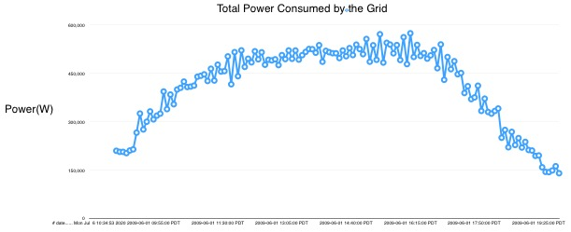
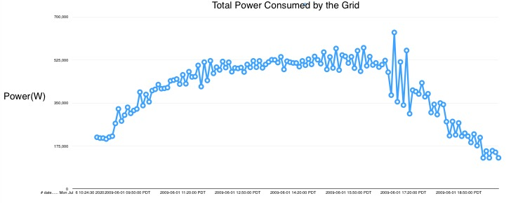
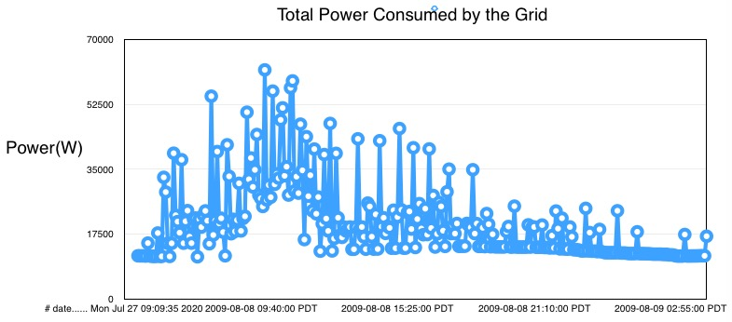
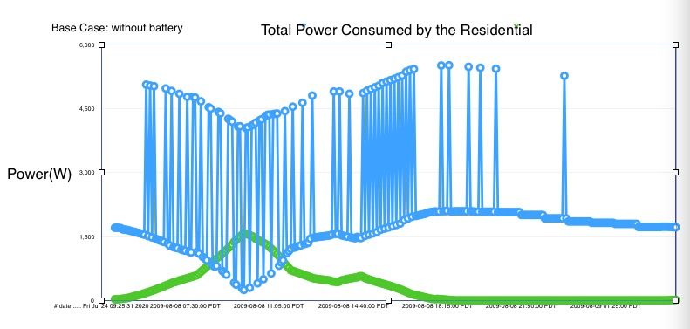
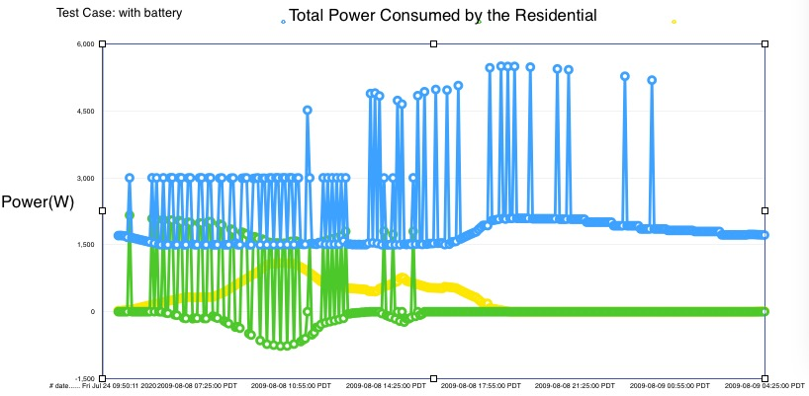
Simulation Results (Use Cases 1-3)
UC1:Peak Load Management
UC2：Wind Energy Balancing Reserves
UC3：High-Penetration PV and Voltage Control

Slide 6
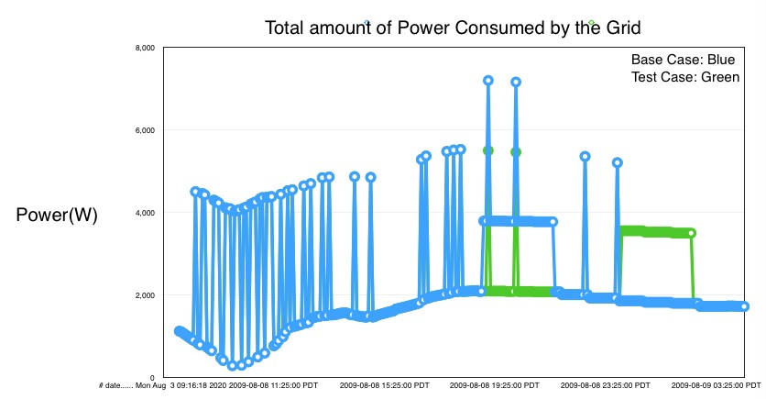
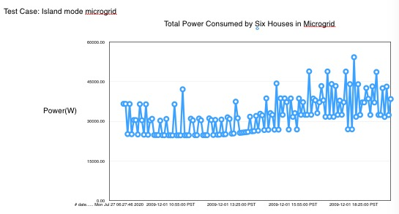
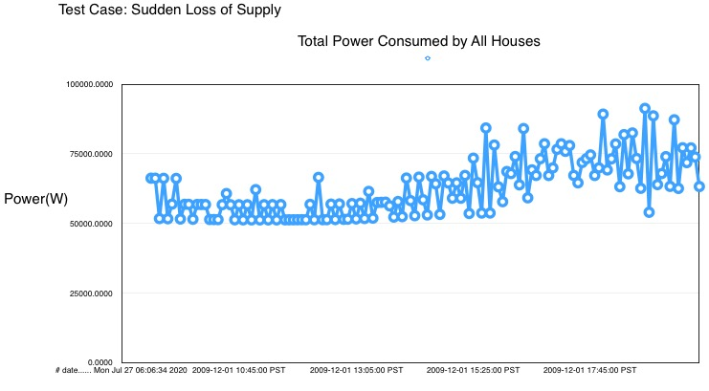
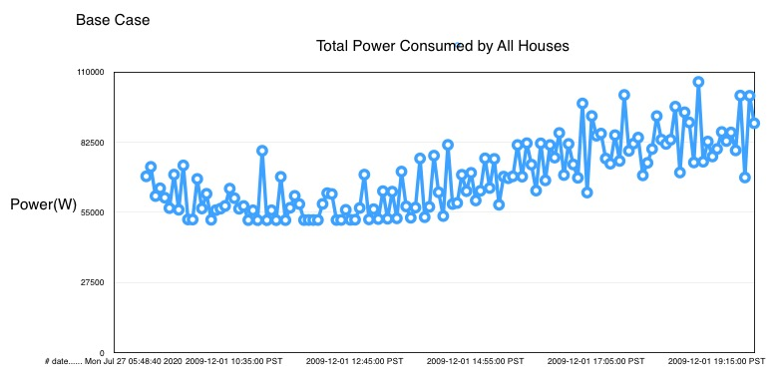
Simulation Results (Use Cases 4-6)
UC4: Electric Vehicle Charging Time Coordination
UC5: Island Mode Microgrid Balancing
UC6: Sudden Loss of Supply Management

